Slide 1

















INT104 – Database Management System Unit – II

Slide 2

Normalization
2 NF
3 NF
2

Slide 3

Functional Dependency
A functional dependency (FD) is a link between two sets of attributes in a relation
Redundancy is often functional dependency
Normalization
caused by a
We can normalise a removing undesirable FDs
1NF
relation by
3

Slide 4

Stages of Normalisation
Unnormalised
(UDF)
Remove repeating groups
First normal form
(1NF)
Remove partial dependencies
Remove transitive dependencies
Second normal form
(2NF)
Third normal form
(3NF)

Slide 5
Database Tables and Normalization
The Need for Normalization
Case of a Construction Company
Building project -- Project number, Name, Employees assigned to the project.
Employee -- Employee number, Name, Job classification
The company charges its clients by billing the hours spent on each project. The hourly billing rate is dependent on the employee’s position.
Periodically, a report is generated.
The table whose contents correspond to the reporting requirements is shown in Table 5.1.
5

Slide 6

Scenario
Project Num : 15
Project Name : Evergreen
A few employees works for one project.
Employee Num : 101, 102, 103,
105
6

Slide 7

Sample Form
Project Num : 15
Project Name : Evergreen
Emp Num | Emp Name | Job Class | Chr Hours | Hrs Billed | Total
101
102
103
105
7

Slide 8
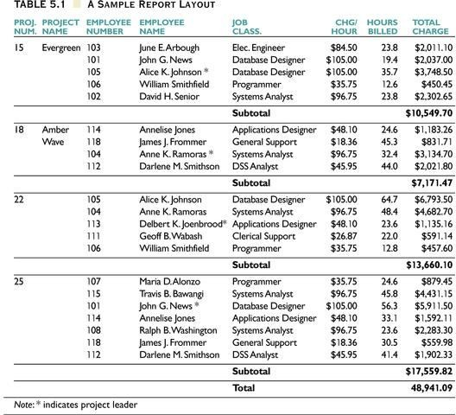

Slide 9
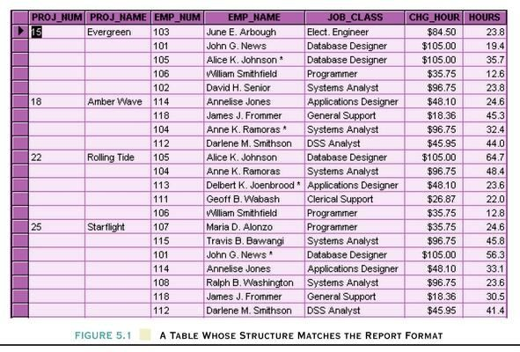
Table Structure Matches the Report Format

Slide 10
Database Tables and Normalization
Problems with the Figure 5.1
The project number is intended to be a primary key, but it contains nulls.

Slide 11
Database Tables and Normalization
Conversion to First Normal Form
A relational table must not contain repeating groups.
Repeating groups can be eliminated by adding the appropriate entry in at least the primary key column(s).

Slide 12
First Normal Form (1 NF)
1NF Definition
The term first normal form (1NF) describes the tabular format in which:
All the key attributes are defined.
There are no repeating groups in the table.
All attributes are dependent on the primary key.

Slide 13
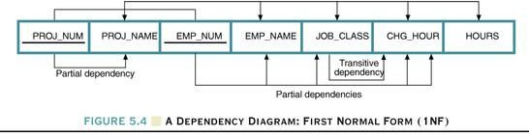
Dependency Diagram
Dependency Diagram
The primary key components are bold, underlined, and shaded in a different color.
The arrows above entities indicate all desirable dependencies, i.e., dependencies that are based on PK.
The arrows below the dependency diagram indicate less desirable dependencies -- partial dependencies and transitive dependencies.

Slide 14
Second Normal Form (2 NF)

Slide 15
Dependency Diagram

Slide 16
Second Normal Form (2 NF)
Conversion to Second Normal Form
Starting with the 1NF format, the database can be converted into the 2NF format by
Writing each key component on a separate line, and then writing the original key on the last line and
Writing the dependent attributes after each new key.
PROJECT (PROJ_NUM, PROJ_NAME)
EMPLOYEE (EMP_NUM, EMP_NAME, JOB_CLASS, CHG_HOUR) ASSIGN (PROJ_NUM, EMP_NUM, HOURS)

Slide 17
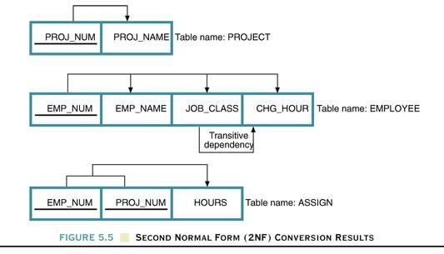
Dependency Diagram

Slide 18
Second Normal Form (2 NF)
A table is in 2NF if:
It is in 1NF and
It includes no partial dependencies; that is, no attribute is dependent on only a portion of the primary key.
(It is still possible for a table in 2NF to exhibit transitive dependency; that is, one or more attributes may be functionally dependent on nonkey attributes.)

Slide 19
Third Normal Form (3 NF)

Slide 20
Dependency Diagram

Slide 21
Third Normal Form (3 NF)
Conversion to Third Normal Form
Create a separate table with attributes in a transitive functional dependence relationship.
PROJECT (PROJ_NUM, PROJ_NAME) ASSIGN (PROJ_NUM, EMP_NUM, HOURS)
EMPLOYEE (EMP_NUM, EMP_NAME, JOB_CLASS) JOB (JOB_CLASS, CHG_HOUR)

Slide 22
Third Normal Form (3 NF)
3NF Definition
A table is in 3NF if:
It is in 2NF and
It contains no transitive dependencies.

Slide 23
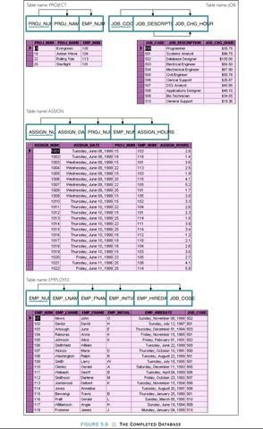
The Completed Database

Slide 24

Third Normal Form
No Repeating Groups
No Partial Dependencies
No Transitive Dependencies.
24

Slide 25
Another Example
Library allows patrons to request books that are currently out
BookNo | Patron | PhoneNo
B3 | J. Fisher | 555-1234
B2 | J. Fisher | 555-1234
B2 | M. Amer | 555-4321

Slide 26
Example
Candidate key is {BookNo, Patron}
We have
Patron → PhoneNo
Table is not 2NF

Slide 27
2NF Solution
Put telephone number in separate Patron table
BookNo | Patron
B3 | J. Fisher
B2 | J. Fisher
B2 | M. Amer
Patron | PhoneNo
J. Fisher | 555-1234
M. Amer | 555-4321

Slide 28
Third Normal Form
A table is in 3NF iff
it is in 2NF and
all its attributes are determined only by its candidate keys and not by any non-prime attributes

Slide 29
Example
Table BorrowedBooks
BookNo | Patron | Address | Due
B1 | J. Fisher | 101 Main Street | 3/2/15
B2 | L. Perez | 202 Market Street | 2/28/15
Candidate key is BookNo
Patron → Address

Slide 30
3NF Solution
Put address in separate Patron table
BookNo | Patron | Due
B1 | J. Fisher | 3/2/15
B2 | L. Perez | 2/28/15
Patron | Address
J. Fisher | 101 Main Street
L. Perez | 202 Market Street

Slide 31
Normalisation to 1NF
To convert to a 1NF relation, split up any non-atomic values
1NF
Unnormalised
Module | Dept | Lecturer | Text
M1 | D1 | L1 | T1
M1 | D1 | L1 | T2
M2 | D1 | L1 | T1
M2 | D1 | L1 | T3
M3 | D1 | L2 | T4
M4 | D2 | L3 | T1
M4 | D2 | L3 | T5
M5 | D2 | L4 | T6
Module | Dept | Lecturer | Texts
M1 | D1 | L1 | T1, T2
M2 | D1 | L1 | T1, T3
M3 | D1 | L2 | T4
M4 | D2 | L3 | T1, T5
M5 | D2 | L4 | T6

Slide 32
Problems in 1NF
1NF
INSERT anomalies
Can't add a module with no texts
UPDATE anomalies
To change lecturer for M1, we have to change two rows
DELETE anomalies
If we remove M3, we remove L2 as well
Module | Dept | Lecturer | Text
M1 | D1 | L1 | T1
M1 | D1 | L1 | T2
M2 | D1 | L1 | T1
M2 | D1 | L1 | T3
M3 | D1 | L2 | T4
M4 | D2 | L3 | T1
M4 | D2 | L3 | T5
M5 | D2 | L4 | T6

Slide 33
Second Normal Form
1NF
1NF is not in 2NF
We have the FD
{Module, Text} →
{Lecturer, Dept}
But also
{Module} → {Lecturer, Dept}
And so Lecturer and Dept are partially dependent on the primary key
Module | Dept | Lecturer | Text
M1 | D1 | L1 | T1
M1 | D1 | L1 | T2
M2 | D1 | L1 | T1
M2 | D1 | L1 | T3
M3 M4 M4 M5
D1 D2 D2 D2
L2 L3 L3 L4
T4 T1 T5 T6

Slide 34
1NF to 2NF – Example
1NF
Module
2NFa
Module
2NFb
Module
Dept
Lecturer
Text
Dept
Lecturer
Text
M1 M1 M2 M2 M3 M4 M4 M5
D1 D1 D1 D1 D1 D2 D2 D2
L1 L1 L1 L1 L2 L3 L3 L4
T1 T2 T1 T3 T4 T1 T5 T6
M1 M2 M3 M4 M5
D1 D1 D1 D2 D2
L1 L1 L2 L3 L4
M1 T1
M1 T2
M2 T1
M2 T3
M3 T4
M4 T1
M4 T5
M1 T6
34

Slide 35
Third Normal Form
2NFa
2NFa is not in 3NF
We have the FDs
{Module} → {Lecturer}
{Lecturer} → {Dept}
So there is a transitive FD from the primary key
{Module} to {Dept}
Module | Dept | Lecturer
M1 | D1 | L1
M2 | D1 | L1
M3 | D1 | L2
M4 | D2 | L3
M5 | D2 | L4

Slide 36
2NF to 3NF – Example
2NFa
Module
3NFa
Lecturer
3NFb
Module
Dept
Lecturer
Dept
Lecturer
M1 M2 M3 M4 M5
D1 D1 D1 D2 D2
L1 L1 L2 L3 L4
L1 L2 L3 L4
D1 D1 D2 D2
M1 M2 M3 M4 M5
L1 L1 L2 L3 L4
36

Slide 37

Normalization
2 NF
3 NF
37

Slide 38

38

